Slide 1
Polytrauma & Spinal Cord Injuries: : A Clinical Pharmacy Perspective
Ahmed M. Sayed
Assistant lecturer
Department of Orthopedics and Trauma Surgery

Slide 2
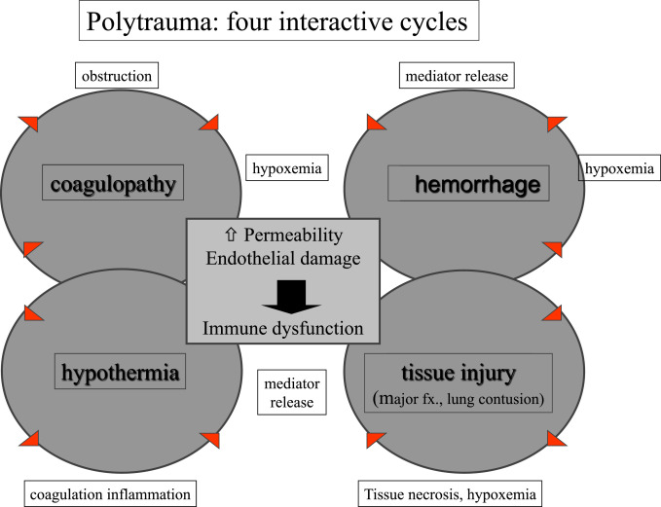
Def. of Polytrauma:
two or more injuries, one of which may be life threatening
sustained in the same incident
that affect multiple body parts or organ systems

Slide 3
Risks with polytrauma:
Death:
  Three peak times:
    50% within the first minutes of sustaining the injury
      caused by massive blood loss or neurologic injury
    30% within hours of arrival to hospital
      most commonly from shock, hypoxia, or neurologic injury
    20% within days to weeks following injury
      multi system organ failure and infection are leading causes
Physical, cognitive, psychological, or psychosocial impairments and functional disability.

Slide 4
How to deal with a polytrauma patient ???
……………Through ATLS

Slide 5
Advanced Trauma Life Support:
A protocol for managing the polytrauma patient
Incudes:
  Primary survey (ABCDE)
    treat greatest threats to life first = Resuscitation
    includes cervical spine control
  Secondary survey
    AFTER life-threatening injuries have been addressed
    Head to toe examination and updated history
    obtain indicated imaging studies
  Tertiary survey
    repeat physical examination and additional imaging as indicated
  Spine injuries are of paramount importance in polytrauma patients
    Can cause spinal cord injuries
    Disability
    Death in high level

Slide 6
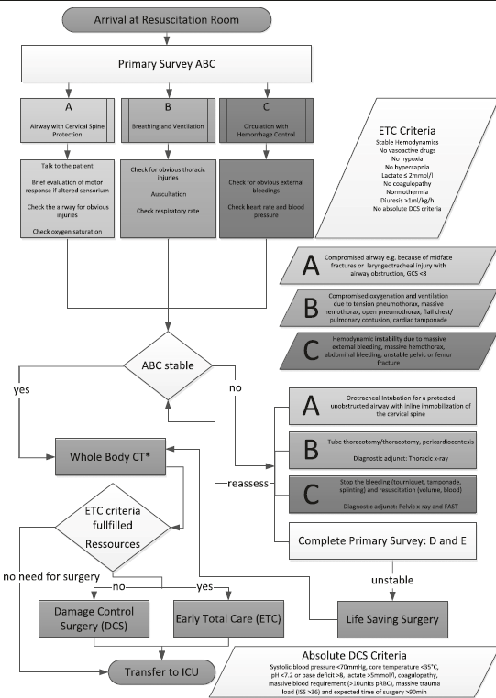

Slide 7
trauma
1st Hit
resuscitation
stratify the pt
stable
borderline
unstable
type of surgical intervention
ETC
DCO
DCO

Slide 8
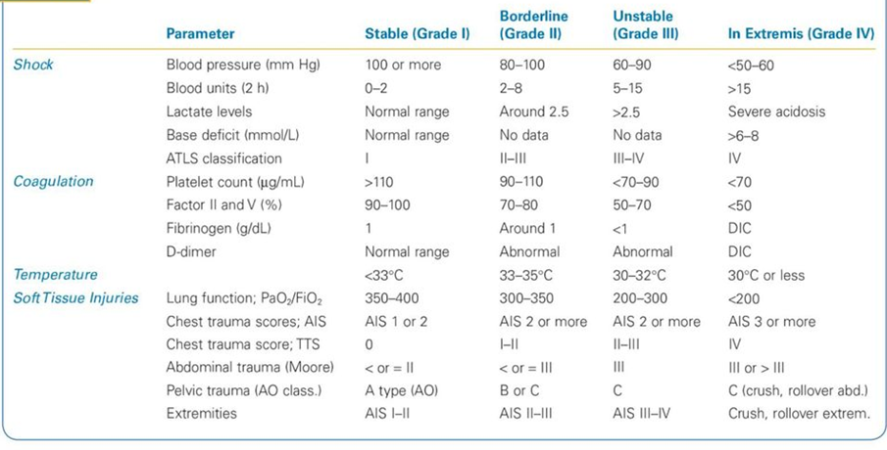

Slide 9
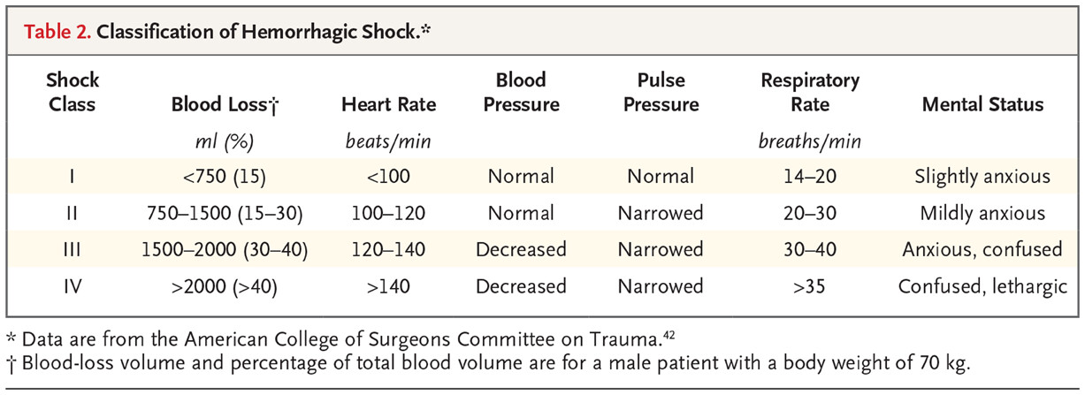

Slide 10
Definitions of ETC and DCO:
Early Total Care:
  the concept of fixing long bone fractures as soon as possible because patients were "too sick not to operate"
  ETC led to exacerbation of the "second-hit" in a subset of patients with hemodynamic instability, head, and/or chest injuries
Damage Control Orthopaedics (DCO)
  definitive treatment delayed until physiology has improved
  replaced the philosophy of Early Total Care (ETC)

Slide 11
Methods of resuscitation:
Crystalloids
  First-line fluid for resuscitation.
  2 L isotonic NaCl or lactated Ringer’s solution as bolus initially.
  Continue until hemodynamic stability is achieved.
  3:1 ratio, ie: 3 L of crystalloid required to raise intravascular volume by 1 L (due to vascular leak).
Colloids
  1:1 ratio.
  Options: Human albumin, hydroxy-ethyl starch, hypertonic saline-dextran.
  Hypertonic saline-dextran: Useful in limited fluid scenarios (e.g., elderly with cardiac impairment).
Blood Transfusion
  Indication: Persistent instability after 2000 mL crystalloid.
  Use O-negative noncrossmatched blood in acute cases (2 U rapidly).
  Type and Cross: Draw sample before transfusion; switch to type-specific blood when available.
  Risks: Coagulopathy with large transfusions.
Coagulopathy Management
  1:1:1 ratio (RBCs : PLTs : Plasma)
  FFP: Infuse after 6-8 U PRBCs or signs of coagulopathy.
  Platelets: Transfuse when depleted or coagulopathy develops.

Slide 12
Indicators of adequate resuscitation
urine output 0.5-1.0 ml/kg/hr (30 cc/hr)
serum lactate levels
  normal < 2.5 mmol/L, < 45 mg/dL
  most sensitive indicator as to whether some circulatory beds remain inadequately perfused
base deficit
  normal -2 to +2

Slide 13
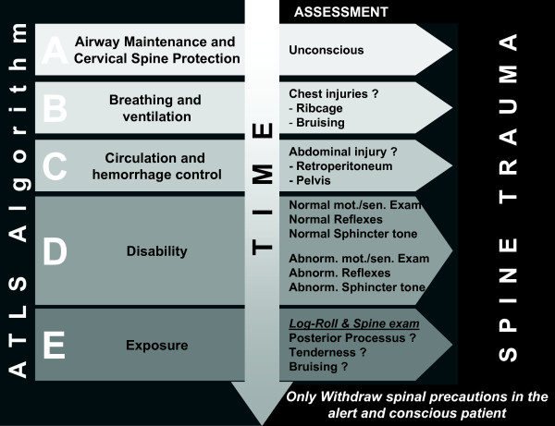

Slide 14
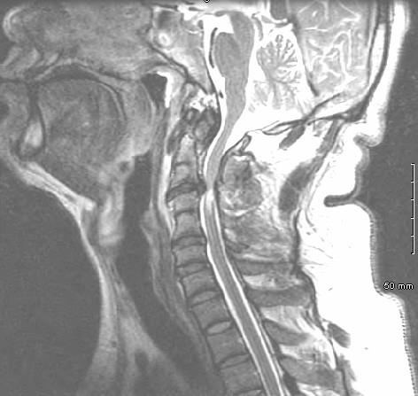
Spinal cord injuries
Demographics
  bimodal distribution
    young individuals with significant trauma
    older individuals that have minor trauma compounded by degenerative spinal canal narrowing
  Anatomic location
    50% in cervical spine

Slide 15
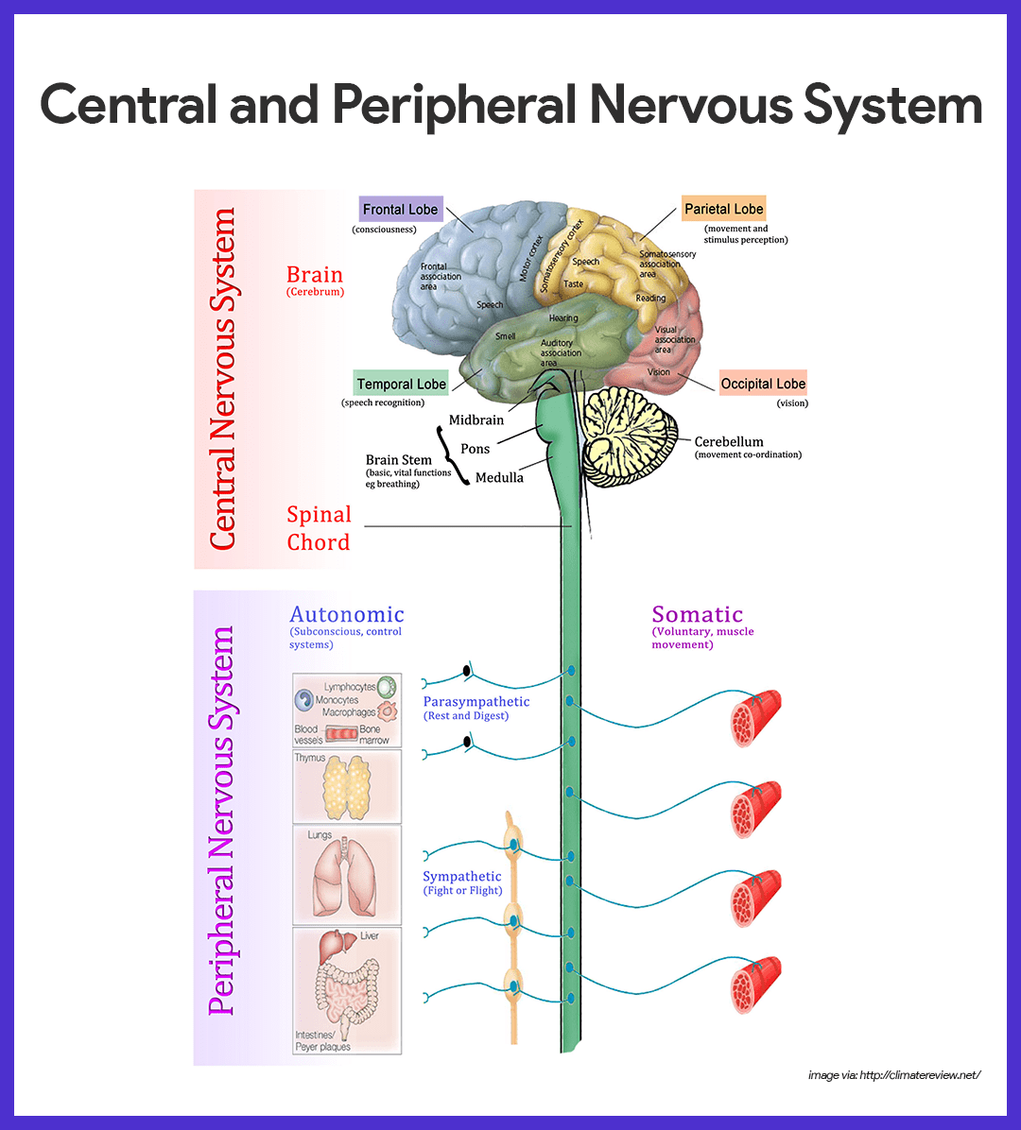
Anatomy of the nervous system:
central nervous system
  brain
  spinal cord
peripheral nervous system
  cranial nerves
  peripheral nerves
autonomic nervous system
  sympathetic system
    a total of 22 ganglia (3 cervical, 11 thoracic, 4 lumbar, and 4 sacral)
  parasympathetic nervous system
    hypogastric plexus
    formed by S2, S3, and S4 parasympathetic fibers and lumbar sympathetic fibers (splanchnic nerves)

Slide 16
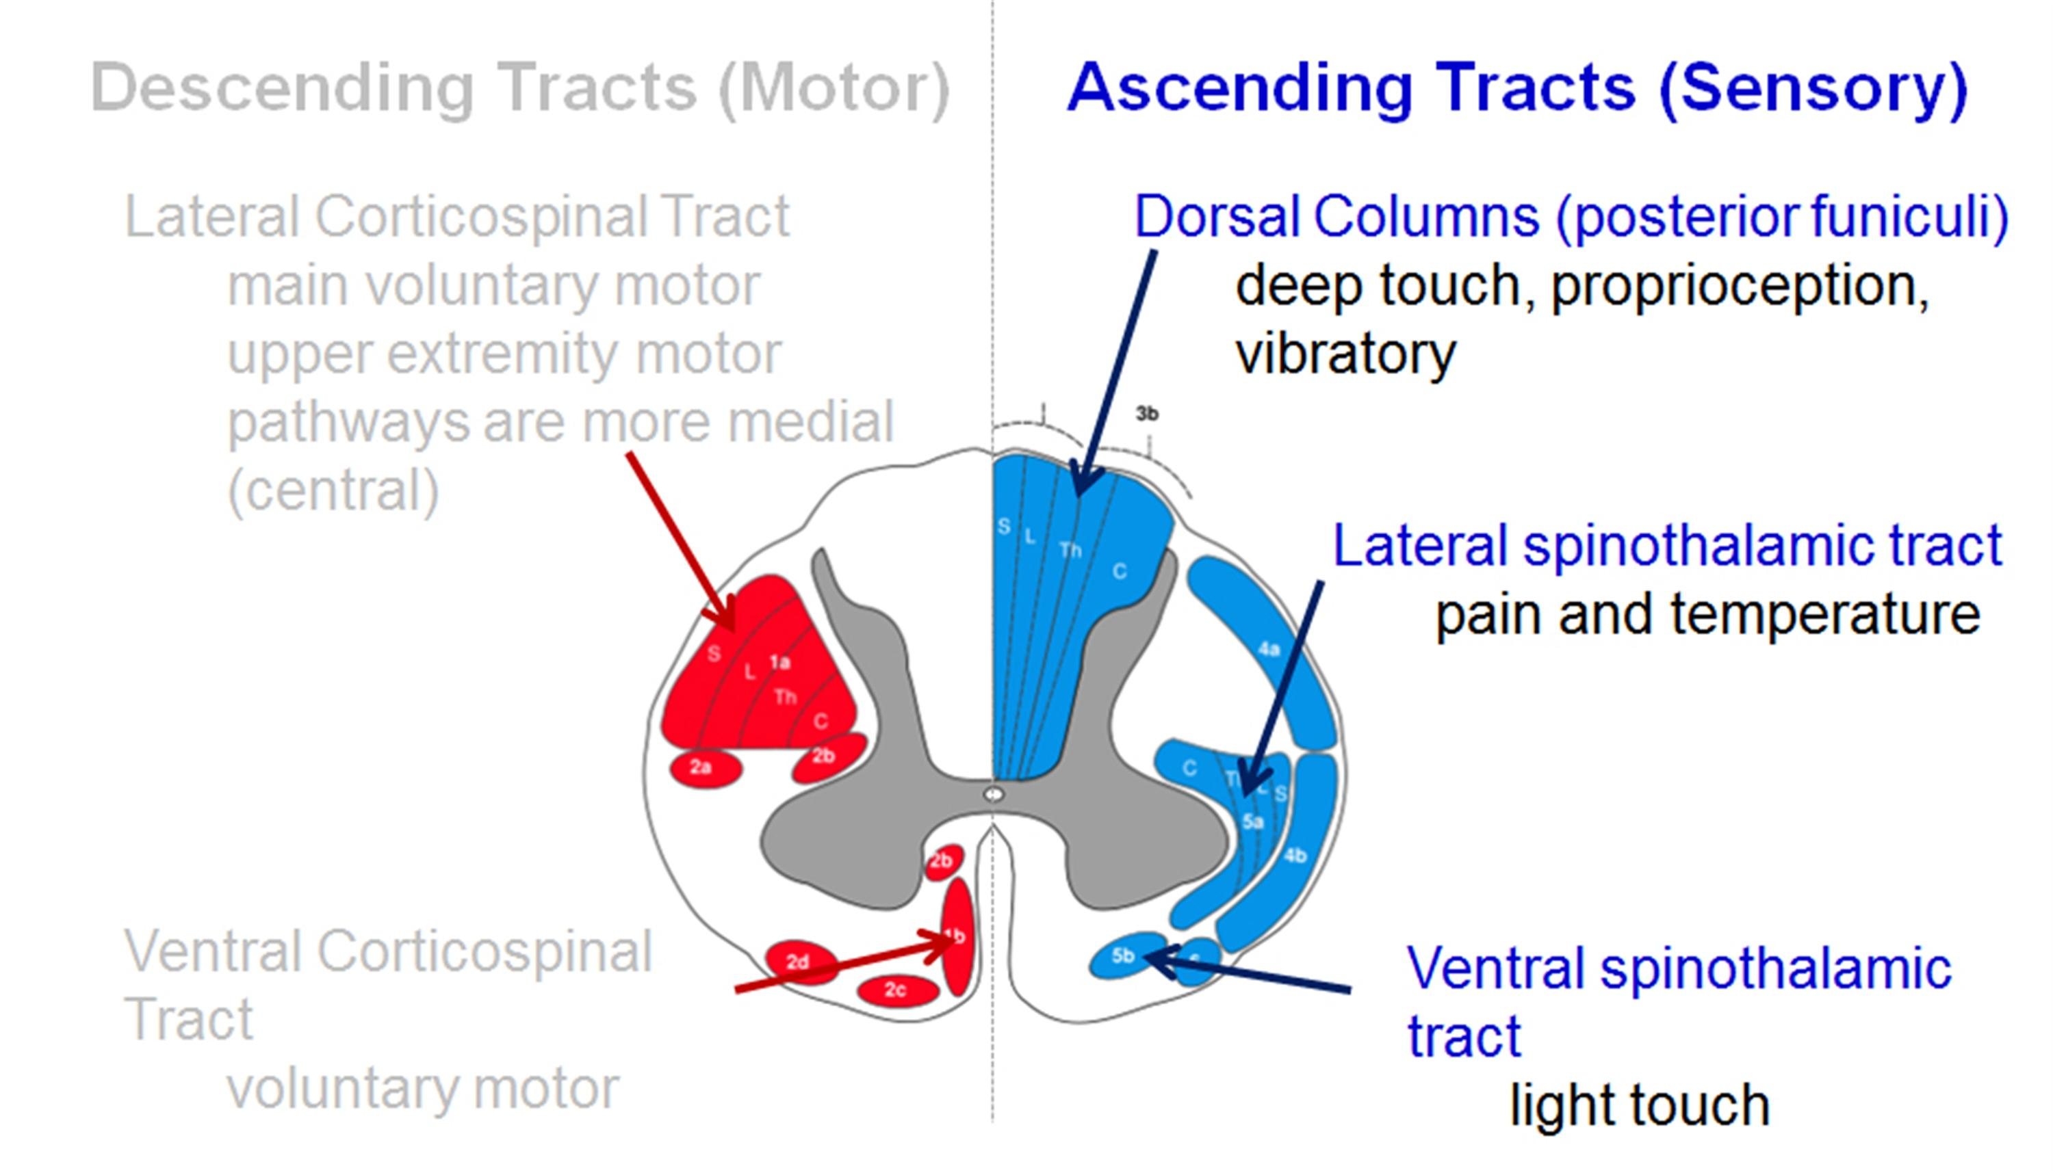
Anatomy of spinal cord:
It consists of tracts; collection of nerve fibers which transmit signals either upwards or downwards.

Slide 17
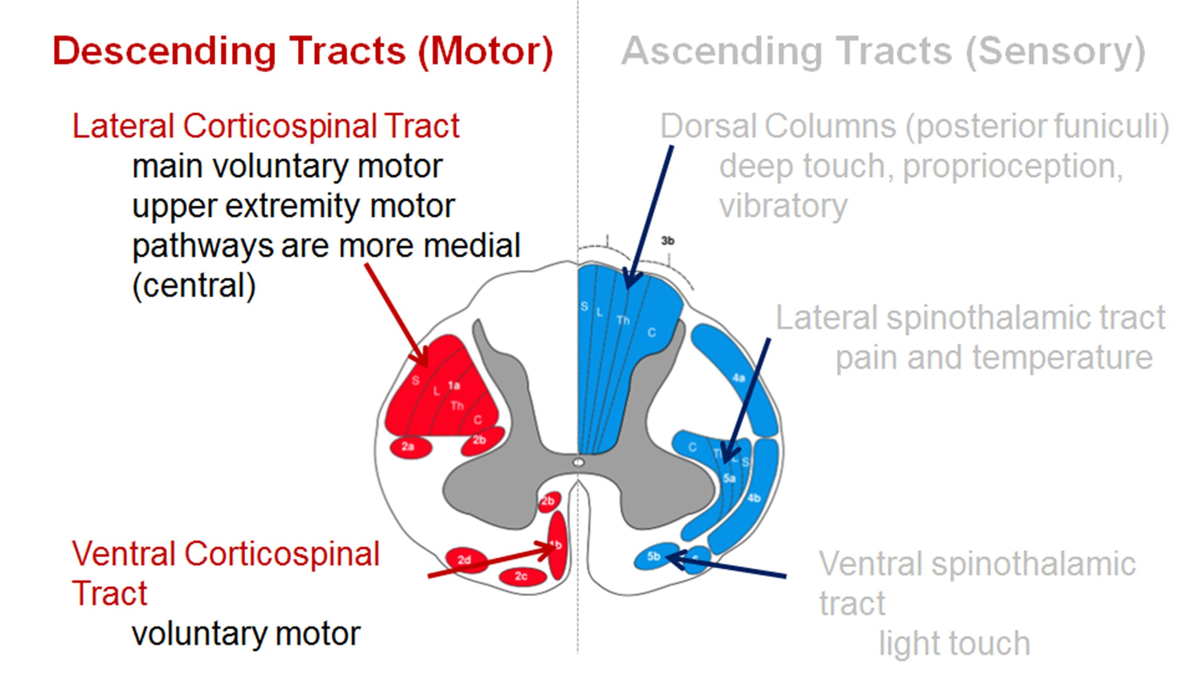

Slide 18
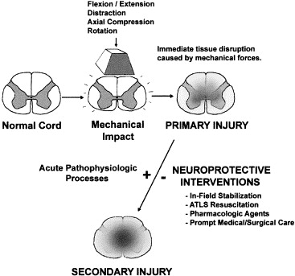
Mechanism of spinal cord injuries:
  MVA causes 50%
  Falls, gunshot, …
Pathophysiology
  primary injury
    damage to neural tissue due to direct trauma
    irreversible
  secondary injury
    injury to adjacent tissue due to
      decreased perfusion
      lipid peroxidation
      free radical / cytokines release
      cell apoptosis
    methylprednisolone used to prevent secondary injury ??
        → by improving perfusion, inhibiting lipid peroxidation, and decreasing the release of free radicals

Slide 19
classification
Quadriplegia
injury to the cervical spinal cord
paraplegia
injury to the thoracic, lumbar, or sacral segments
arm function is preserved
complete injury
an injury with no spared motor or sensory function below the affected level
incomplete injury
an injury with some preserved motor or sensory function below the injury level
leading to impairment of function in the arms, trunk, legs, and pelvic organs
leading to impairment of function in the trunk, legs, and pelvic organs depending on the level of injury

Slide 20
Medical ttt for patients with spinal cord injuries:
DVT prophylaxis
modalities
low-molecular weight heparin
rotating bed
pneumatic compression stocking
Cerebrolysin (CBL)
Peptide with neurotrophic and neuroprotective activity
Steroids
high dose methylprednisolone
Controversial now
Load 30mg/kg in 1 hr
Maintain 5.4mg/kg/hr
Max 48 hrs
Urinary tract infections:
Proper antibiotics + sterile catheterization techniques
Bowel management
High Fibre Diet
Adequate Fluid Intake
Medication
Oral e.g. Bowel Softeners
Rectal e.g. Enemas
Sinus bradycardia
most common cardiac arrhythmia in acute stage following SCI
Orthostatic hypotension
occurs because of lack of sympathetic tone

